Slide 1
Case 3: Venous Thromboembolism (VTE) / Urinary Tract Infection (UTI)
Patient case: Mrs. Jones is a 67-year-old female, height 165cm, weight 65kg, BMI: 23.9
Current problems: Recurrent Venous Thromboembolism (VTE)
Current medications:
Warfarin (5mg / day): the patient is on long-term anticoagulation therapy for recurrent VTE; warfarin was chosen due to financial considerations.
New problem: Urinary Tract Infection (UTI)
Management scenario: The patient presented recently with a strong and persistent urge to frequently urinate and describes a burning sensation when urinating.
A preliminary diagnosis of cystitis UTI was confirmed by lab results. For the last episode of UTI, she was prescribed TMP/SMX (Bactrim, 2 double-strength tablets orally, twice daily for at least 3 days), which was well-tolerated by the patient.
The same treatment for the current episode of cystitis UTI is followed.

Slide 2
Clinical Guidelines
[1] International Clinical Practice Guidelines for the Treatment of Acute Uncomplicated Cystitis and Pyelonephritis in Women, 2010, Clinical Infectious Diseases (IDSA). LINK
[2] Impact of preemptive warfarin dose reduction on anti-coagulation after initiation of trimethoprim-sulfamethoxazole or levofloxacin, 2008, Journal of thrombosis and thrombolysis. LINK
[3] Guidance for the practical management of warfarin therapy in the treatment of venous thromboembolism. 2016, Journal of thrombosis and thrombolysis. LINK

Slide 3
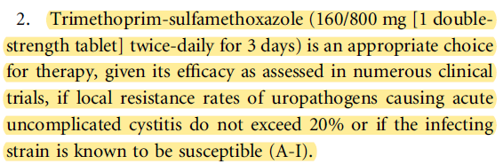
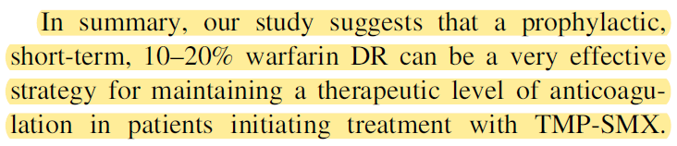
Clinical Guidelines: Highlighted Parts (1)
International Clinical Practice Guidelines for the Treatment of Acute Uncomplicated Cystitis and Pyelonephritis in Women
Impact of preemptive warfarin dose reduction on anti-coagulation after initiation of trimethoprim-sulfamethoxazole or levofloxacin
[1] p. 3
[2] p. 4

Slide 4
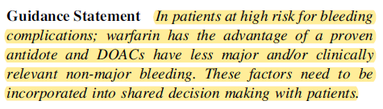
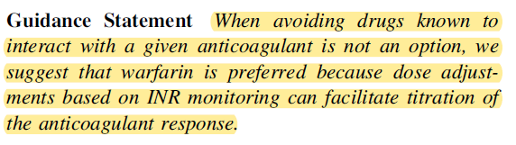
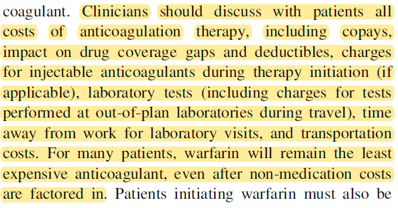
[3] Guidance for the practical management of warfarin therapy in the treatment of venous thromboembolism (2)
[3] p. 189
[3] p. 190
[3] p. 190

Slide 5
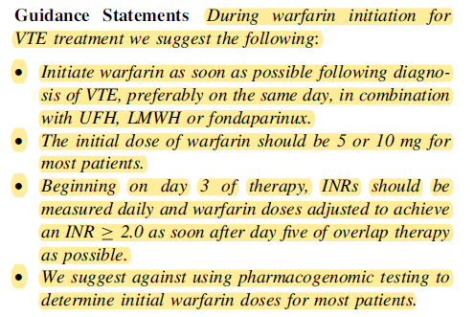
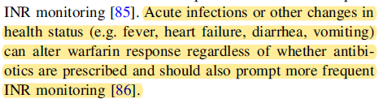
[3] Guidance for the practical management of warfarin therapy in the treatment of venous thromboembolism (3)
[3] p. 191
[3] p. 195

Slide 6
Mitigation of Adverse Interactions
Adverse interactions
Antibiotics such as TMP/SMX are known to potentiate the anticoagulant effect of warfarin.
Acute infections can alter warfarin response regardless of whether antibiotics are prescribed.
Suggested treatment
Pre-emptive reduction of 10% of warfarin dosage. Given that her daily warfarin dose is 5 mg (weekly dosage of 35 mg), her reduced daily dose becomes 4.5 mg per day.
Daily checking of INR value, starting from day 3 of overlapping TMP/SMX therapy, with warfarin dosage being adjusted as needed, with the goal of achieving an INR >= 2 as soon as possible.
Relevant aspects
Level of evidence for treatment (e.g., warfarin vs. DOAC)
Patient burden (e.g., daily INR checks) and preference (e.g., financial considerations)

Slide 7
Features for decision support
 | - type of interaction
A2 | Two or more drugs from different CPGs may interact | TMP/SMX affects anticoagulant effect of warfarin
A6 | Temporal relationship between different CPGs | Evolution of INR value during overlapping treatment
 | - types of mitigation
B2 | Adjust drug dosage | Prophylactic reduction of warfarin dosage ; Adjustment of warfarin dosage during overlapping treatment
B3 | Monitor the effect of a drug | Monitor INR value during overlapping treatment
 | - Other features
C1 | Patient preferences and/or patient burden | Choice of warfarin due to financial reasons
The solution does not need to address C1

